Slide 1
Introduction to Large Language Models
Albert Gatt & Ayoub Bagheri
Utrecht University

Slide 2
Goals of this short course
Main goal: understanding the fundamentals of (large) language models
The language modeling objective
Sequences and the encoder-decoder architecture
Attention
Transformer models

Slide 3
Language modelling

Slide 4
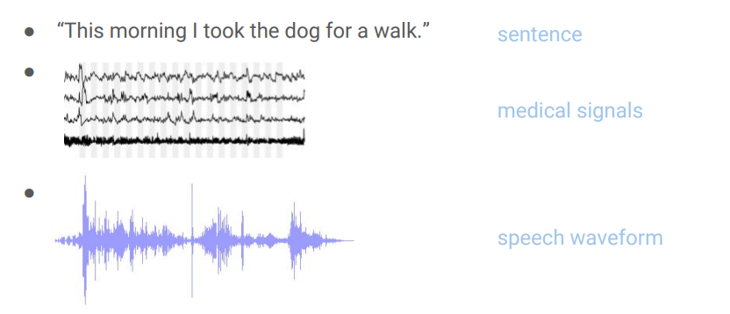
It’s about sequences
© MIT 6.S191: Introduction to Deep Learning IntroToDeepLearning.com

Slide 5
Sequence modelling
This morning I took the dog for a……. walk
This morning I took the dog to the……vet
Given: history/context
predict what comes next

Slide 6
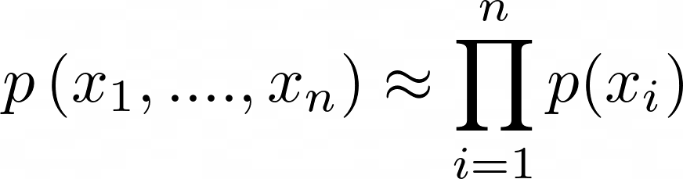
Approach 1: fixed window (n-grams)
Model the sequence in terms of smaller sub-sequences of length n (e.g. n=1, 2 or 3)
Unigram (1-gram):
Bigram:

Slide 7
Would a bigram model handle this?
This morning I took the dog for a……. walk
This morning I took the dog to the……vet
But surely, predicting walk/vet also depends on dog?
With a simple Markov model like this, we cannot model long-term dependencies.
Given: history/context
p(walk | this morning…) = p(walk | a)
p(vet | this morning…) = p(vet | the)

Slide 8
Long-distance dependencies
Word probabilities:
In Spain, I ate a lot of paella and learnt some Spanish.
Pronouns and their antecedents:
John told me he was leaving on the 24th.
Mary told me she was leaving on the 24th.

Slide 9
Bag of words?
Idea: treat the whole sequence as a multiset (“bag”), where each element is represented by a count.
We can also weight such counts in various ways, e.g. TF/IDF
This morning I took the dog for a
But BoW doesn’t preserve order. These two are equivalent:
In Spain, I ate a lot of paella and learnt some Spanish.
I ate some paella and learnt a lot of Spanish in Spain.

Slide 10
Suppose we use a really big fixed-window?
More or less, like using n-grams with larger values for n
E.g. consider previous 5 words
This morning I took the dog to the……vet

Slide 11
Long-distance dependencies (again)
Word probabilities:
In Spain, I ate a lot of paella and learnt some Spanish.
Pronouns:
John told me he was leaving on the 24th.
Mary told me she was leaving on the 24th.
Distance is not fixed:
John, who is my mother’s brother, told me he was leaving on the 24th.
Mary, who is my father’s sister, told me she was leaving on the 24th.

Slide 12
Summary: The challenges of sequences
Ideally, we want to deal with:
variable length
order preservation
long-distance dependencies
parameter sharing across the sequence

Slide 13
Recurrent networks

Slide 14
Recurrent Neural Networks (RNNs)
Rationale:
Rather than fixing the amount of history our network can handle, we allow it to accumulate a representation over time.
This can work over arbitrary sequences.
Hopefully, it will also encode similar things in similar ways (less representational redundancy).
In the accumulated representation, it should also capture dependencies between elements at different (possibly distant) time-steps.

Slide 15
Recurrent Neural Network
Output y
this
Output y
morning
Output y
walk
RNN
RNN
RNN
… … …
Input x
<START>
Input x
this
Input x
a

Slide 16
Recurrent Neural Network
Output y
this
Output y
morning
Output y
walk
RNN
RNN
RNN
… … …
Input x
<START>
Input x
<START> this
Input x
<START> this morning I took the dog for a
RNN maintains a hidden state across timesteps which accumulates the sequence representation.

Slide 17
Unrolled RNN
y₁
y₂
y₃
y_{t-1}
y_{t}
V
V
V
V
V
h₁
W
h₂
W
h₃
W
h_{t-1}
W
h_{t}
h₀
…
U
U
U
U
U
x₁
x₂
x₃
x_{t-1}
x_{t}
Processes a sequence x₁,…, x_{t} via hidden units h₁,…,h_{t} to yield an output sequence.
Key property: share parameter matrices U, W and V across time.

Slide 18

Recurrent neural network: parameters
y₁
y₂
y₃
y_{t-1}
y_{t}
V
V
V
V
V
h₁
W
h₂
W
h₃
W
h_{t-1}
W
h_{t}
h₀
…
U
U
U
U
U
x₁
x₂
x₃
x_{t-1}
x_{t}
Recurrence formula
Often, g = tanh
Previous hidden state
Shared W
Input vector at current timestep. Shared U

Slide 19
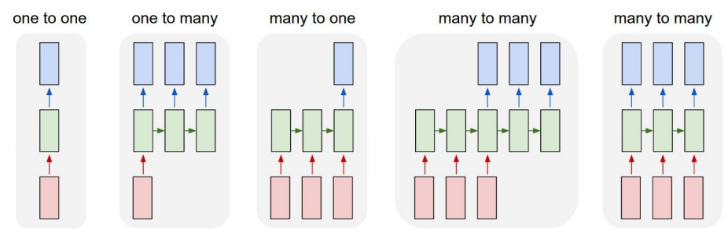
Recurrent Neural Networks: Process Sequences
CS231n: Convolutional Neural Networks

Slide 20
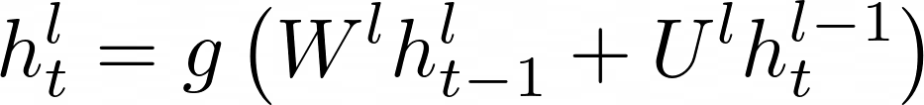
Depth
y₁
y₂
y₃
y_{t-1}
y_{t}
h²₁
h²₂
h²₃
h²_{t-1}
h²_{t}
…
h¹₁
h¹₂
h¹₃
h¹_{t-1}
h¹_{t}
…
RNN with two layers.
x₁
x₂
x₃
x_{t-1}
x_{t}
We can stack multiple hidden layers in the RNN and connect them.
Each layer has its own weight matrix for hidden states (W) and inputs (U) are:
Input from the previous layer (= x at layer 1)

Slide 21
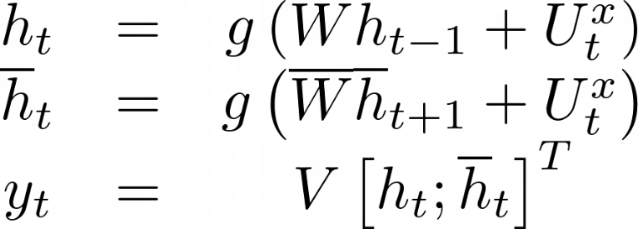
Bidirectionality
y₁
y₂
y₃
y_{t-1}
y_{t}
h₁
h₂
h₃
h_{t-1}
h_{t}
…
h₁
h₂
h₃
h_{t-1}
h_{t}
…
x₁
x₂
x₃
x_{t-1}
x_{t}

Slide 22
Gating (brief outline)
RNNs can handle arbitrary sequences, but they do forget!
During training, long-distance dependencies are “lost” as the impact of early elements is diminished over time.
Gated Recurrent Unit (GRU)
Long Short-term Memory (LSTM) network
Two variations of RNNs use “gates” to allow the network to selectively retain or “forget” information.

Slide 23

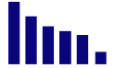

Training with cross-entropy loss
vet
Loss is averaged over the sequence:
Reference
this
morning
Loss
- log y_{this}
- log y_{morning}
- log y_{vet}
Prediction y
Softmax
RNN
RNN
RNN
… … …
Input x
<START>
this
vet

Slide 24
Prediction with a trained RNN
Prediction y
this
morning
vet
Softmax
RNN
RNN
RNN
… … …
Input x
<START>
this
vet

Slide 25
Encoder-Decoder Architecture

Slide 26
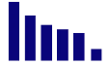
Causal (“auto-regressive”) generation
Basic idea: condition next word prediction on the preceding word, plus the hidden state.
Prediction y
this
morning
vet
Softmax
RNN
RNN
RNN
… … …
Input x
<START>
this
vet

Slide 27
Causal (“auto-regressive”) generation
At each time step t, sample from the vocabulary V, and choose the most likely next element, based on:
Current hidden state (which accumulates the representation up to t-1)
Previous word generated at t-1
Notice, however, that this generates random sequences.
What is the text being generated actually about?
Suppose we want to generate from some input?
Idea: condition word choice based on the input, as well as previously generated words.

Slide 28
Encoder-Decoder architecture
Output text
ENCODER
DECODER
( = a language model)
context
Input text or data
DECODER
Conditioned on hidden state of the encoder.
Produce output by sampling from a probability distribution.
At each time-step, we predict the next token.
ENCODER
Transform input to a vector representation (the context).
Representation is available in the network’s hidden layer.
Sutskever, I., Vinyals, O., & Le, Q. V. (2014). Sequence to sequence learning with neural networks. Advances in Neural Information Processing Systems 27 (NIPS’14), 3104–3112. http://papers.nips.cc/paper/5346-sequence-to-sequence-learning-with-neural
Cho, K., van Merriënboer, B., Gulcehre, C., Bahdanau, D., Bougares, F., Schwenk, H., & Bengio, Y. (2014). Learning Phrase Representations using RNN Encoder–Decoder for Statistical Machine Translation. Proceedings of the 2014 Conference on Empirical Methods in Natural Language Processing (EMNLP), 1724–1734. https://doi.org/10.3115/v1/D14-1179

Slide 29
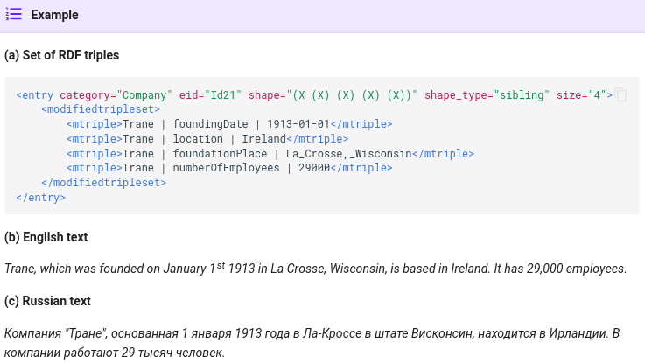
Encoder-Decoder architecture
ENCODER
DECODER
(= language model)
context
Example from the WebNLG challenge
https://webnlg-challenge.loria.fr/challenge_2020/

Slide 30
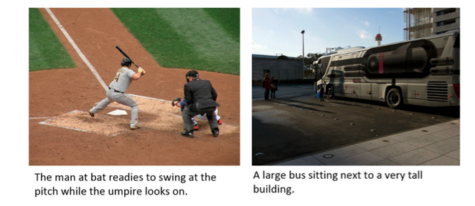
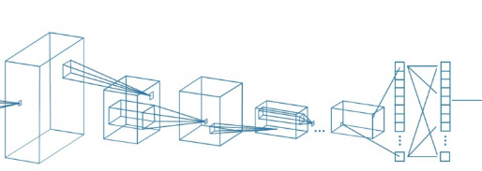
Encoder-Decoder architecture
ENCODER
DECODER
( = language model)
context
Image and caption taken from the COCO Challenge.
https://cocodataset.org/#captions-2015

Slide 31
Where do we factor in the context?
Various ways to do this. Here are two:
Initialise
Initialise the decoder with the encoder’s last hidden state
During decoding, decoder predicts the next element with the previous hidden state and the predictions generated so far.
Use context at each step
Inject the context into each time-step of the decoder
At each timestep, decoder predicts based on its previous hidden state, predictions generated so far, and the context.

Slide 32
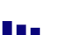
The encoder-decoder model at inference time (NB: context injected at each step)
y₁
y₂
<END>
h^{e}₁
h^{e}₂
h^{e}_{n}
h^{e}_{n} = h^{d}₁
h^{d}₁
h^{d}₂
h^{d}_{n}
...
...
x₁
x₂
x_{n}
_{<START>}
y₁
y_{n}

Slide 33
Where does attention come into the picture?
Output text
ENCODER
DECODER
(= language model)
context
Input text or data
The original E-D creates a bottleneck: All the input is compressed into a dense representation, which is used throughout decoding.
Attention mechanisms allow the decoder to learn to differentiate between parts of the input context. So at each time-step, we train it to pay more attention to relevant portions of the input.
Transformers are based on a generalization of the attention mechanism.

Slide 34
Attention in Encoder-Decoder models
y₁
Decoder
h^{d}₁
h^{d}₂
…
What is the relevant context at h^{d}₂?
Take h^{d}1
Compare it to each of: h^{e}₁ to h^{e}_{n}
Weight context vector accordingly
h^{e}₁
h^{e}₂
h^{e}_{n}
...
x₁
x₂
x_{n}
Encoder

Slide 35
Attention in Encoder-Decoder models
Suppose input is of length n. Then the Encoder has n states, one for each time-step (word etc): h^{e}₁...h^{e}_{n}
Let c_{i} be the decoder context at timestep i. We want this to reflect how relevant each encoder state is to the decoder state h^{d}_{i-1}.
We capture this by comparing h^{d}_{i-1} to each encoder state h^{e}_{j}.

Slide 36


Attention in Encoder-Decoder models
Capture their similarity: compare the decoder state to each encoder state:
Normalise scores using softmax (turn them into a distribution):
Use that distribution to compute a weighted average over all the hidden encoder states:
Notes:
It’s possible to have more sophisticated versions of this idea. For example, the initial scoring function, which captures the similarity or relevance of encoder states to decoder state, could be parameterized, with an additional weight matrix. This makes the network learn the similarity or relevance function. This also means we can have decoder and encoder hidden states of different dimensionality, whereas up to now we’ve been assuming that they have to have the same dimensionality.

Slide 37
What does this do?
Hopefully, during training, we achieve a way to identify, at each time-step in the decoder, which part of the source encoding is most relevant.
y_{i}
Y_{i+1}
α_{1,i-1}
α_{2,i-1}
α_{n,i-1}
h^{d}_{i-1}
h^{d}_{i}
...
h^{e}₁
h^{e}₂
...
h^{e}_{n}
Y_{i-1}
y_{i}
x₁
x₂
x_{n}

Slide 38
Attention as “alignment”
Bahdanau, D., Cho, K., & Bengio, Y. (2015). Neural Machine Translation By Jointly Learning To Align and Translate. Proceedings of the International Conference on Learning Representations (ICLR’15), 1–15. https://doi.org/10.1146/annurev.neuro.26.041002.131047
Xu, K., Ba, J. L., Kiros, R., Cho, K., Courville, A., Salakhutdinov, R., Zemel, R. S., & Bengio, Y. (2015). Show, Attend and Tell: Neural Image Caption Generation with Visual Attention. Proceedings of the International Conference on Learning Representations (ICLR’15). http://arxiv.org/abs/1502.03044

Slide 39
Summary for today
Language modelling objective
Basically, word prediction given a preceding context.
Recurrent networks
Architecture to handle sequences of arbitrary length.
Endoder-Decoder
Architecture (originally with RNNs) to drive a language model to generate, conditioned on input context.
Attention
Key step to condition the LM selectively on different parts of the input, at each timestep.

Slide 40
What’s next?
The current generation of “large language models” is based on Transformer architectures.
These generalise the notion of attention, while removing recurrence completely.
Next time:
Generalisation of attention
Transformers and self-attention
Concrete examples of transformer-based LMs.

